Slide 1

Smart Gym Tracker
Increment 1 Delivery

Slide 2


What is Smart Gym Tracker
Web based gym metrics tracking application
User-friendly interface
Simple look, but powerful features
Personalized and tailored experience for each user's desires
Users can track:
Workouts
Biometrics
Trends
Goal progress

Slide 3


Delivery Goals for Increment 1
Document plans going forward
Create shells of systems
Create class libraries
Iron out features goals and deliverables

Slide 4
Updates and changes On Project Goals
Positive Updates:
On schedule for project features and releases
Documentation and future plans defined
Class library and core data requirements created
Frontend designs and pages are on track
Backend exists
Database schema created
Bugs:
No bugs at current time
All systems will build and run to current deliverable standards
Blockers:
No cross-system communication
Makes testing of some functionality difficult
Planned to be implemented in Increment 2

Slide 5
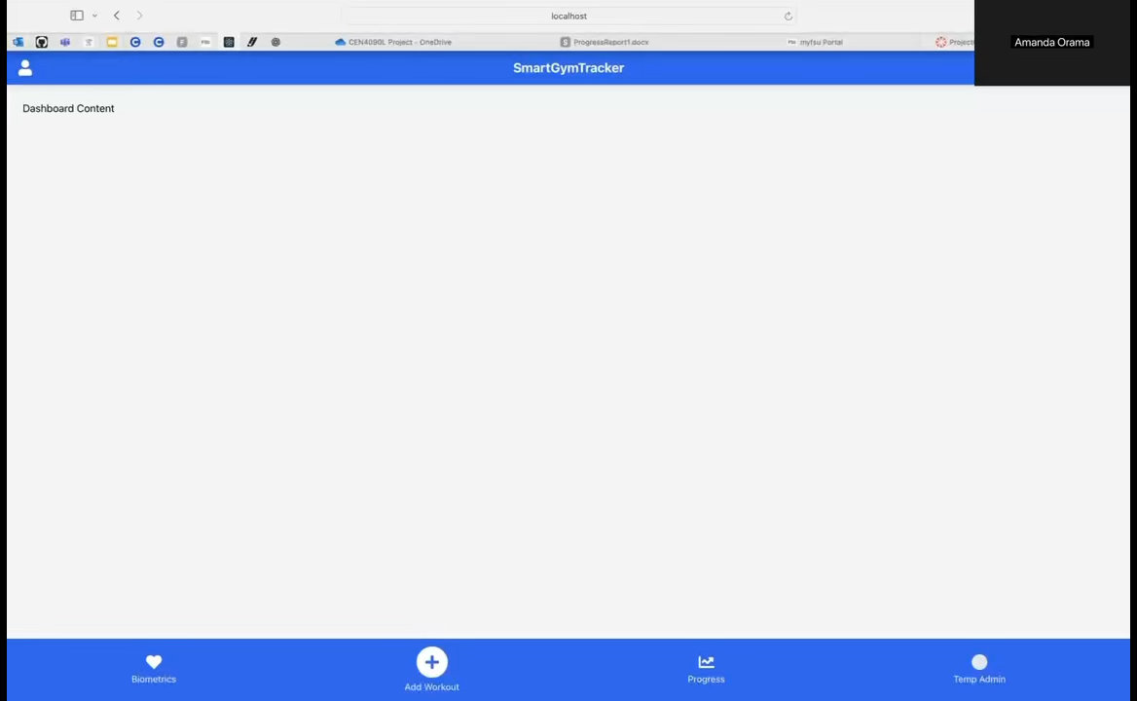
Demo - Frontend

Slide 6
Future Deliverables
Increment 2 Release (11/7):
Get the frontend, backend, and database communicating
Users and Identity Management (IDM)
Login Screen
Create new user
Forgot my password
Populate user permissions and data upon login
Admin login
Admin specific pages
User Management Page
Increment 3 Release (12/12):
Trends of Data
See graphs of how data has changed over time
Notifications
Create user inbox dashboard messages to populate
Smart Tips and Suggestions
See goals and tips based off data trends
Milestone and Progress Tracking
Personalized goals creation
See progress over time towards these user created goals

Slide 7


Thank You
Questions?

